Slide 1
Rule-Based Classification

Slide 2
Using IF-THEN Rules for Classification
Uses a set of IF-THEN rules for classification
IF condition THEN conclusion
Either from a decision tree or directly from the training data using a sequential covering algorithm.
Eg. R1: IF age = youth AND student = yes THEN buys computer = yes.
The “IF”-part (or left-hand side)of a rule is known as the rule antecedent or precondition.
The “THEN”-part (or right-hand side) is the rule consequent.
If the condition consists of one or more attribute tests they are logically ANDed.
Eg. Also write R1: (age = youth) ^ (student = yes)=>(buys computer = yes).

Slide 3
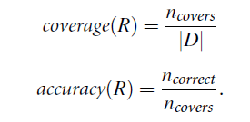
If the condition in a rule antecedent holds true for a given tuple, the rule is satisfied and the rule covers the tuple.
A rule R can be assessed by its Coverage and Accuracy
Given a tuple, X, from a class labeled data set,D, let
n_{covers} -number of tuples covered by R
n_{correct} – number of tuples correctly classified by R
|D|-the number of tuples in D

Slide 4
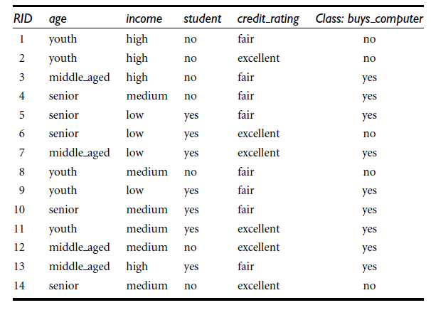

Slide 5
Example R1:IF age = youth AND student = yes THEN buys computer = yes.
Coverage(R1) = 2/14 = 14.28%
Accuracy (R1) = 2/2 = 100%.
If a rule is satisfied by X, the rule is said to be triggered.
X= (age = youth, income = medium, student = yes, credit rating = fair).
X satisfies R1, which triggers the rule.
If R1 is the only rule satisfied, then the rule fires by returning the class prediction for X.
If more than one rule is triggered
What if they each specify a different class ?
What if no rule is satisfied by X?

Slide 6
If more than one rule is triggered- Conflict resolution strategy
Size ordering
Rule ordering
Size Ordering
Assigns the highest priority to the triggering rule that has the “toughest” requirements
Toughness is measured by the rule antecedent size.
Rule ordering-prioritizes the rules beforehand
Class based
The classes are sorted in order of decreasing “importance,” such as by decreasing order of prevalence
All of the rules for the most prevalent (or most frequent) class come first, the rules for the next prevalent class come next, and so on.
Within each class, the rules are not ordered
Rule-based
The rules are organized into one long priority list, according to some measure of rule quality such as accuracy, coverage, or size
When rule ordering is used, the rule set is known as a decision list.
The triggering rule that appears earliest in the list has highest priority, and so it gets to fire its class prediction.
Any other rule that satisfies X is ignored.
Most rule-based classification systems use a class-based rule-ordering strategy.
If there is no rule satisfied by X, a fallback or default rule can be set up to specify a default class, based on a training set.

Slide 7
Rule Extraction from a Decision Tree
Decision tree classifiers are a popular method of classification.
It is easy to understand how decision trees work and they are known for their accuracy.
Decision trees can become large and difficult to interpret.

Slide 8
Rule Extraction from a Decision Tree
One rule is created for each path from the root to a leaf node
Each splitting criterion along a given path is logically ANDed to form the rule antecedent (“IF” part).
The leaf node holds the class prediction, forming the rule consequent (“THEN” part).

Slide 9
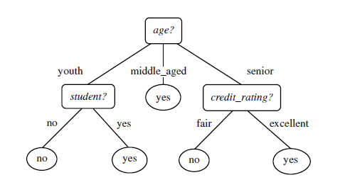
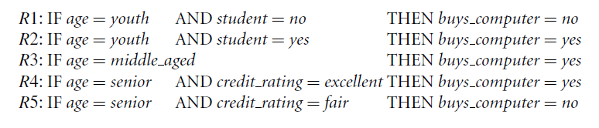

Slide 10
A disjunction (logical OR) is implied between each of the extracted rules.
Because the rules are extracted directly from the tree, they are Mutually exclusive and exhaustive
Mutually exclusive -no two rules will be triggered for the same tuple.
Exhaustive- there is one rule for each possible attribute-value combination.
Does not require a default rule.
Therefore, the order of the rules does not matter—they are unordered.
The resulting set of rules extracted can be large and difficult to follow, because some of the attribute tests may be irrelevant or redundant.
Pruning the rule set- any condition that does not improve the estimated accuracy of the rule can be pruned.
C4.5 extracts rules from an unpruned tree, and then prunes the rules using a pessimistic approach.
The training tuples and their associated class labels are used to estimate rule accuracy.
Problem - the rules will no longer be mutually exclusive and exhaustive

Slide 11
Rule Induction Using a Sequential Covering Algorithm
IF-THEN rules can be extracted directly from the training data.
Rules are learned sequentially, where each rule for a given class will ideally cover many of the tuples of that class.
Egs. AQ, CN2, RIPPER-Seq. Covering Algo. Variations.
Rules are learned one at a time.
Each time a rule is learned, the tuples covered by the rule are removed, and the process repeats on the remaining tuples.

Slide 12
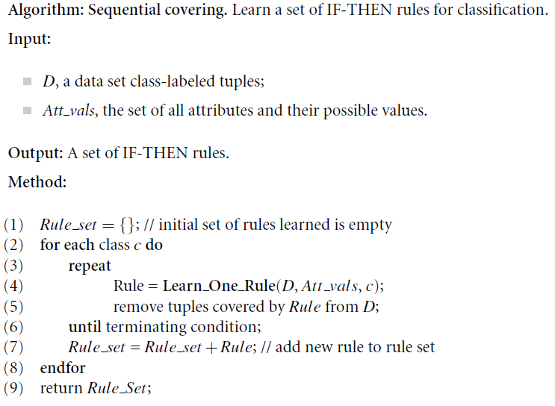

Slide 13
How are rules learned?
Rules are grown in a general-to-specific manner.
A beam search.
Start off with an empty rule and then gradually keep appending attribute tests to it.
Append by adding the attribute test as a logical conjunct to the existing condition of the rule antecedent.
IF THEN loan decision = accept
A new attribute is added to the current rule, which most improves the rule quality, based on the training samples.
Suppose the algorithm finds attribute test income = high best improves the accuracy of our current (empty) rule.
We append it to the condition, so that the current rule becomes
IF income = high THEN loan decision = accept.
Each time we add an attribute test to a rule, the resulting rule should cover more of the “accept” tuples.
Next iteration, consider the possible attribute tests and end up selecting credit rating = excellent
IF income = high AND credit rating = excellent THEN loan decision = accept

Slide 14
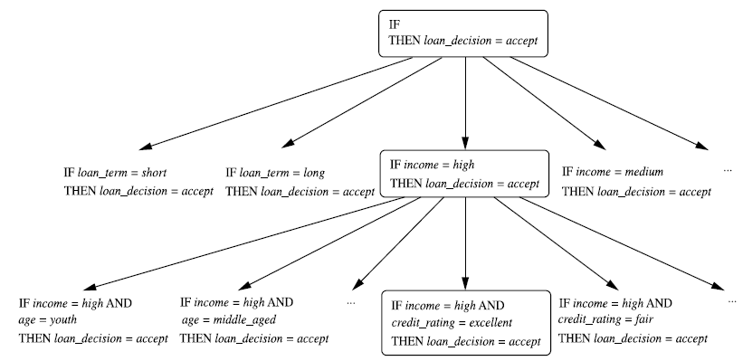

Slide 15
How are rules learned?(cond..)
The process repeats, where at each step, we continue to greedily grow rules until the resulting rule meets an acceptable quality level.
Greedy search does not allow for backtracking.
At each step, we heuristically add what appears to be the best choice at the moment.
What if we unknowingly made a poor choice along the way?
Instead of selecting the best attribute test to append to the current rule, we can select the best k attribute tests.
In this way, we perform a beam search of width k wherein we maintain the k best candidates overall at each step, rather than a single best candidate.

Slide 16
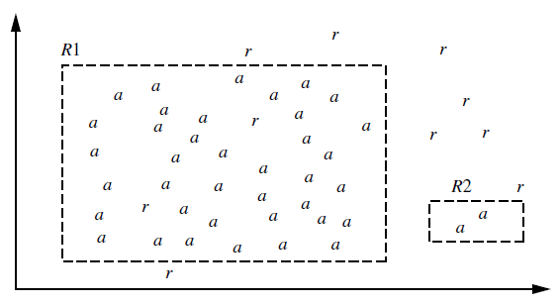
Rule Quality Measures
Choosing between two rules based on accuracy
Rule R1 correctly classifies 38 of the 40 tuples it covers. Rule R2 covers only two tuples, which it correctly classifies.
Their accuracies are 95% and 100%.
R2 has greater accuracy than R1,but it is not the better rule because of its small coverage.

Slide 17
Accuracy and coverage
Entropy based on information gain.
Likelihood Ratio- Statistical test that considers coverage.
Information gain proposed in FOIL (First Order Inductive Learner).

Slide 18
Rule Quality Measures
Suppose we are learning rules for the class c.
Our current rule is R: IF condition THEN class = c.
We want to see if logically ANDing a given attribute test to condition would result in a better rule.
We call the new condition, condition’, where R’: IF condition’ THEN class = c is our potential new rule.
i.e; we want to see if R’ is any better than R.

Slide 19
Entropy
It is also known as the expected information needed to classify a tuple in data set, D.
Here, D is the set of tuples covered by condition’ and p_{i} is the probability of class C_{i} in D.
The lower the entropy, the better condition’ is.
Entropy prefers conditions that cover a large number of tuples of a single class and few tuples of other classes.

Slide 20

Information gain proposed in FOIL (First Order Inductive Learner)
In machine learning, the tuples of the class for which we are learning rules are called positive tuples, while the remaining tuples are negative.
Let pos (neg) be the number of positive(negative) tuples covered by R.
Let pos’ (neg’) be the number of positive (negative)tuples covered by R’.
FOIL assesses the information gained by extending condition as
It favors rules that have high accuracy and cover many positive tuples.

Slide 21

Likelihood ratio statistic
We can use a statistical test of significance to a genuine correlation between attribute values and classes.
Likelihood ratio statistic:
where m is the number of classes.
For tuples satisfying the rule, fi is the observed frequency of each class i among the tuples.
ei is what we would expect the frequency of each class i to be if the rule made random predictions.
The statistic has a χ ² distribution with m-1 degrees of freedom.
The higher the likelihood ratio is, the more likely that there is a significant difference in the number of correct predictions made by our rule.

Slide 22

Rule Pruning
A rule is pruned by removing a conjunct (attribute test)
We choose to prune a rule, R, if the pruned version of R has greater quality, as assessed on an independent set of tuples called pruning set.
pos and neg are the number of positive and negative tuples covered by R
If the FOIL Prune value is higher for the pruned version of R, then we prune R.

